Slide 1
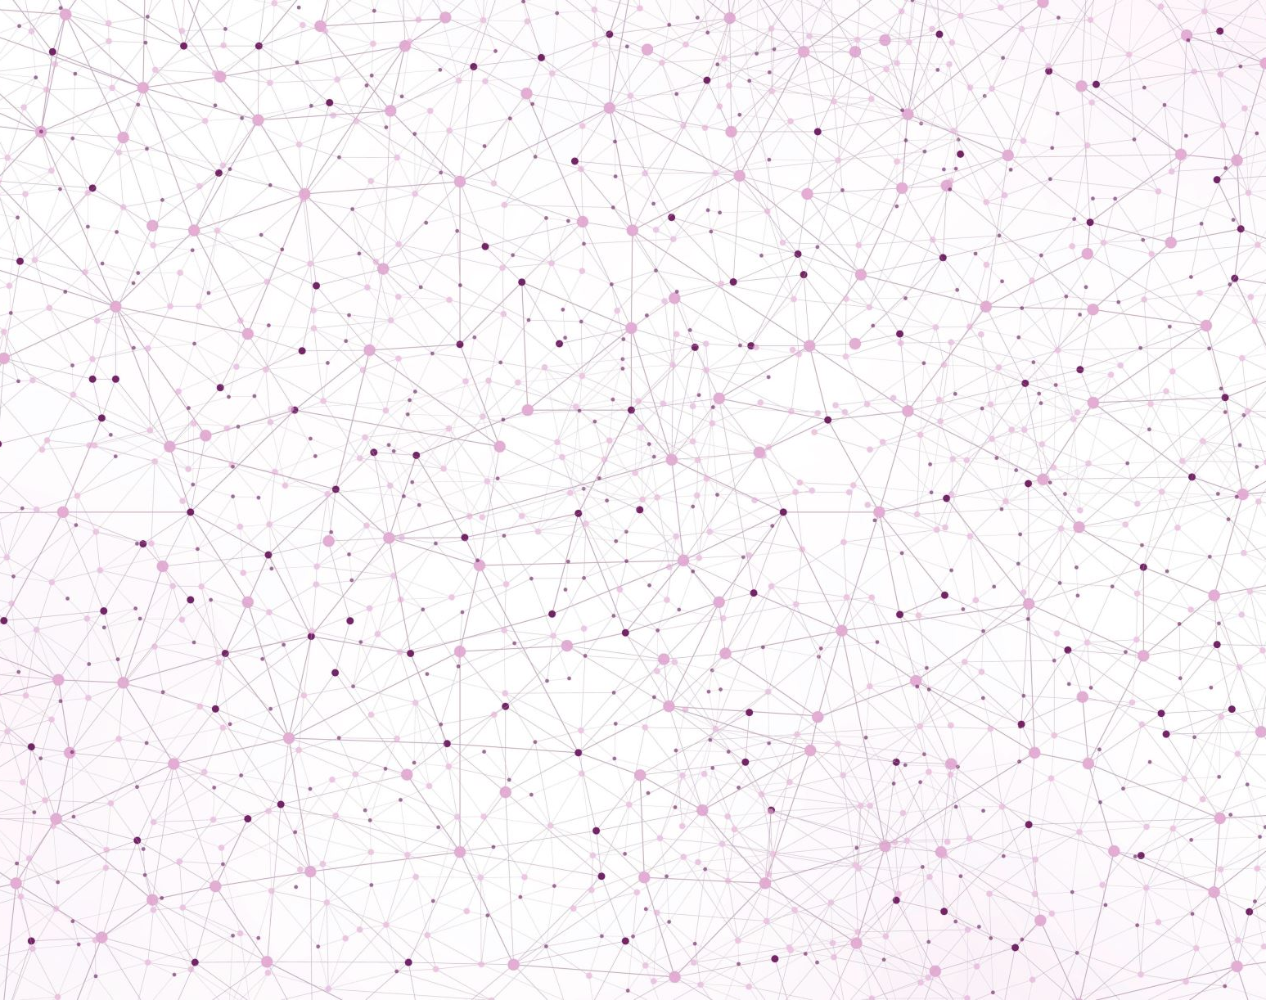
Deep Learning CAD Project Defense
Abdelrahman HABIB

Slide 2
Outline
Augmentation & Pre-processing
General augmentation/pre-processing
Hair augmentation (segmentation + augmentation)
Segmentation Masks
Architectures
Base Architecture with visual attention blocks
Ensemble 5-folds Architecture
Configurations (Experiments Controllers)
Results & Discussion
Grad-CAM Visualization
Conclusion

Slide 3
[1/7] Augmentation & Pre-processing _{(1/3)}
Train
Validation
Test
1. CropFrame ^{(a)}
8. OneOf (MotionBlur, MedianBlur, GaussianBlur, GaussNoise)
1. CropFrame^{(a)}
2. AdvancedHairAugmentation^{(a)}
2. Resize
3. HorizontalFlip
9. CLAHE
3. Normalize
4. VerticalFlip
10. Transpose
5. ColorJitter
11. HueSaturationValue
Returns:
- image
- segmentation mask ^{(b)}
- label ^{(c)}
6. Rotate
12. Resize
7. RandomBrightnessContrast
13. Normalize
Custom pre-processing function added to the augmentation transformer with probability (p), (1. p = 100%, 2. p=50%).
Depends on the experiment, we return the mask or None.
Random labels for test as we don’t use it (labels are generally based on the filename (class) and index.
Notes:
The preprocessing (CropFrame) and AdvancedHairAugmentation were wrapped as Albumentation package functions to be called at the augmentation transformer, with probability of 100% for CropFrame as it has a validation inside it to not crop images without microscopic view, and also to make the images similar to the masks dimensions as they were also processed with the same functions. The AdvancedHairAugmentation had probability of 50%, where internally, it had another random hair generator of 0 to 5 new hairs, with random rotations, flip, and number …
We will talk about the hair augmentation in a next slide.

Slide 4
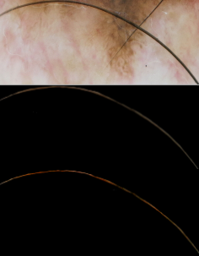
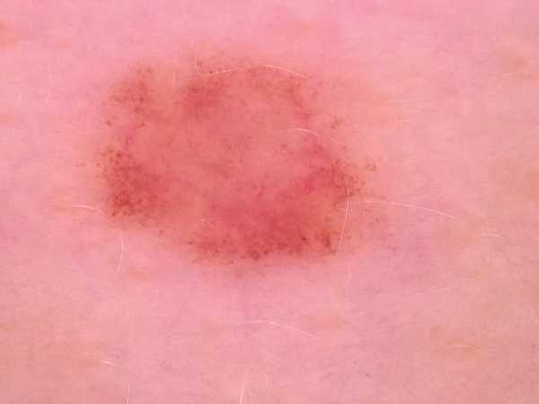
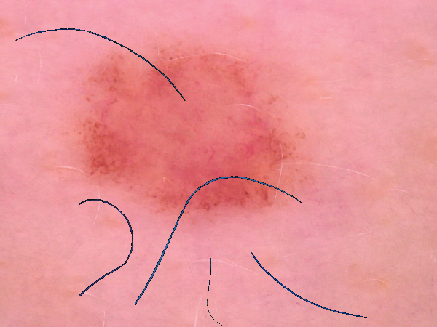
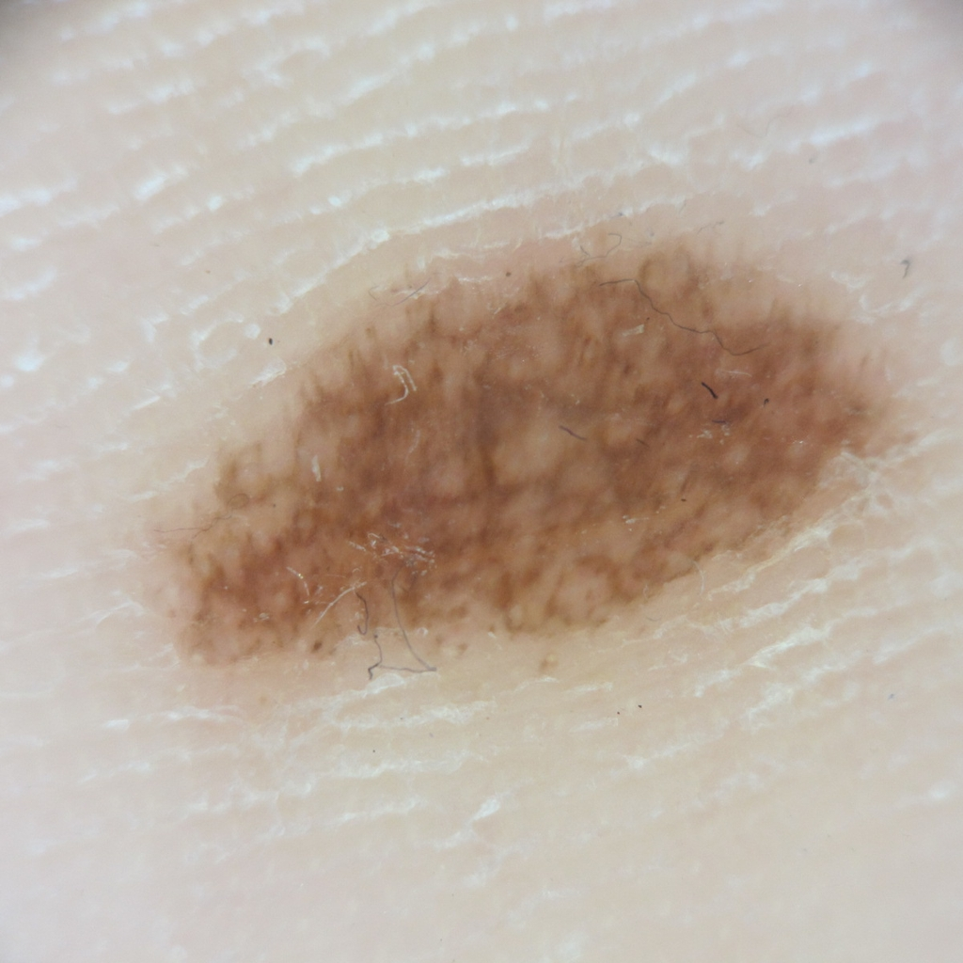
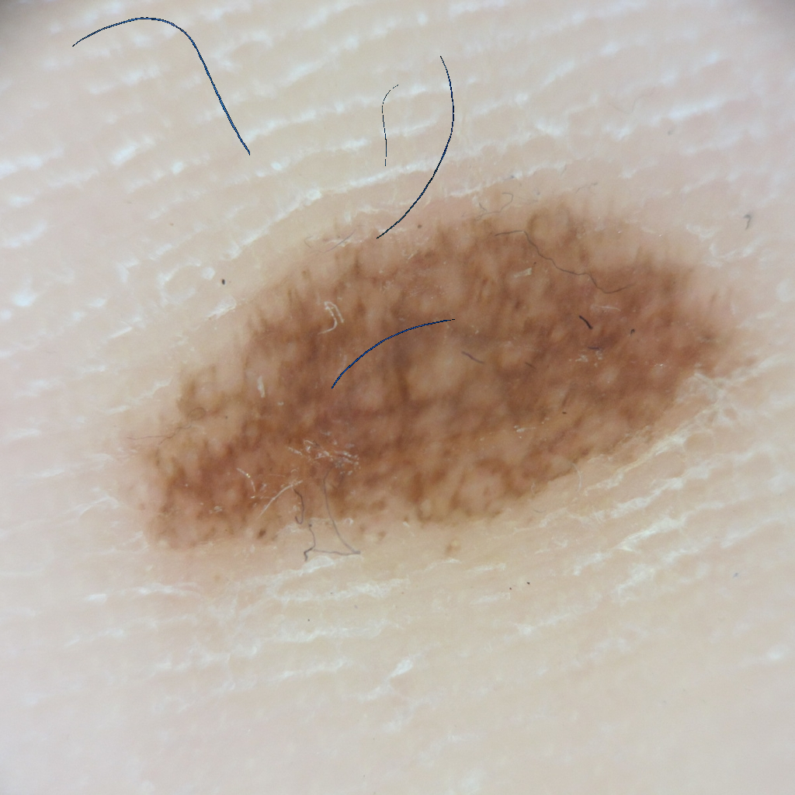
[1/7] Augmentation & Pre-processing – Hair Augmentation _{(2/3)}
Sample to segment
Manual Hair Segmentation
Resized, Adjusted Contrast
Segmented 5 hair samples from different lesions. The resize and contrast/intensity adjustment is to ensure that the augmented hair is small & dark. Hair is augmented with random rotation, flip, sizes, and maximum 5 new hairs in each image [0 to 5].
Notes:
The hair was segmented manually by hand from 5 images, and resized then adjusted the contrast to be smaller than the images and not affect the overall image features. This way, we are solving two problems:
The model will no longer learn that certain group of images (that could belong to a specific class due to imbalance) have hair, and others not; this way, we are adding hair with a probability to all images and forcing the model to learn that it is the problem of the entire dataset and not a specific feature for a specific group.
By adding hair (and not removing it with inpainting), we are avoiding manipulating or altering (all) of the image's texture/color features. As there is no distinctive way to detect hair, the inpainting will affect negatively all images. Adding hair avoids the inpainting process and adds the hair in a way that it is random and doesn’t alter the image features.

Slide 5
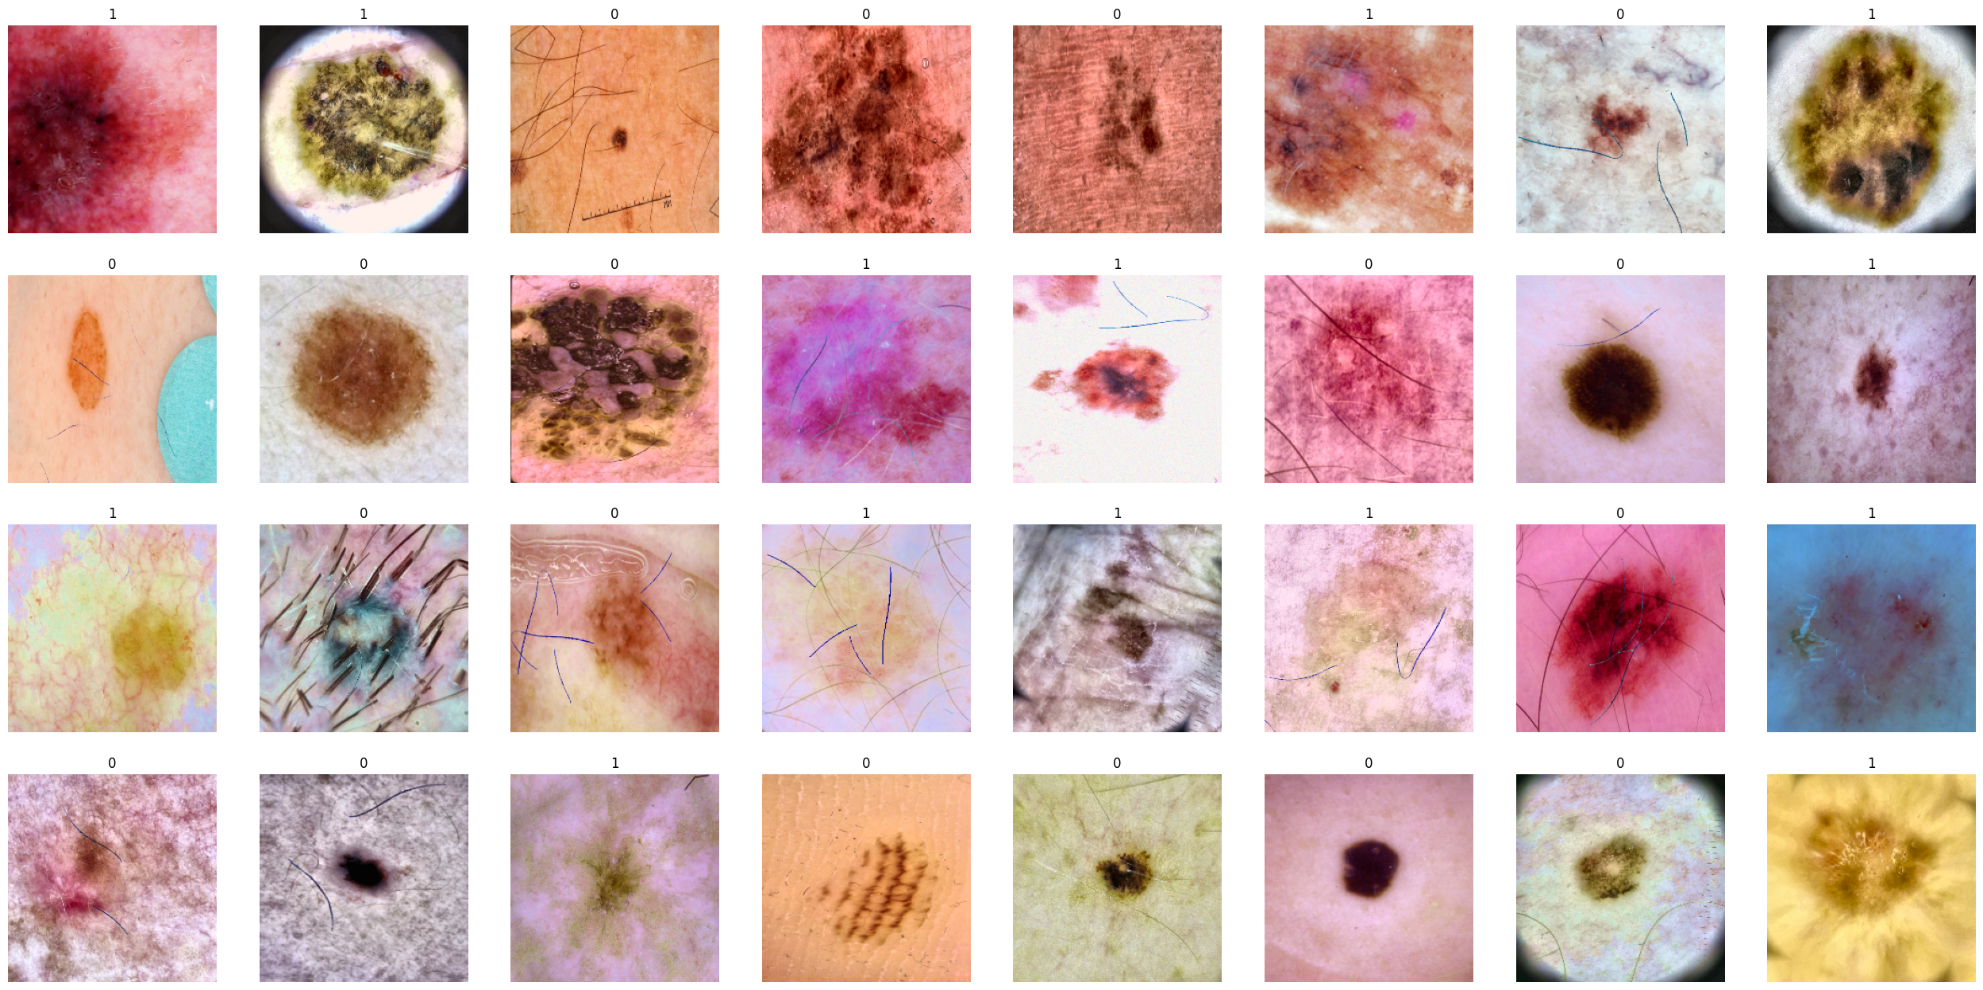
[1/7] Augmentation & Pre-processing (Results) _{(3/3)}
Notes:
Example of the full augmentation process.

Slide 6
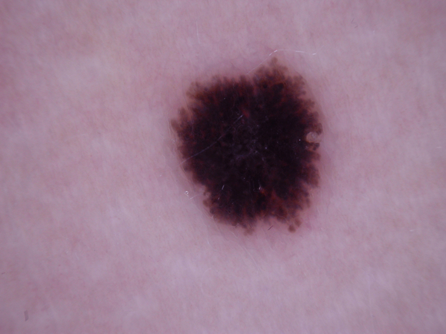
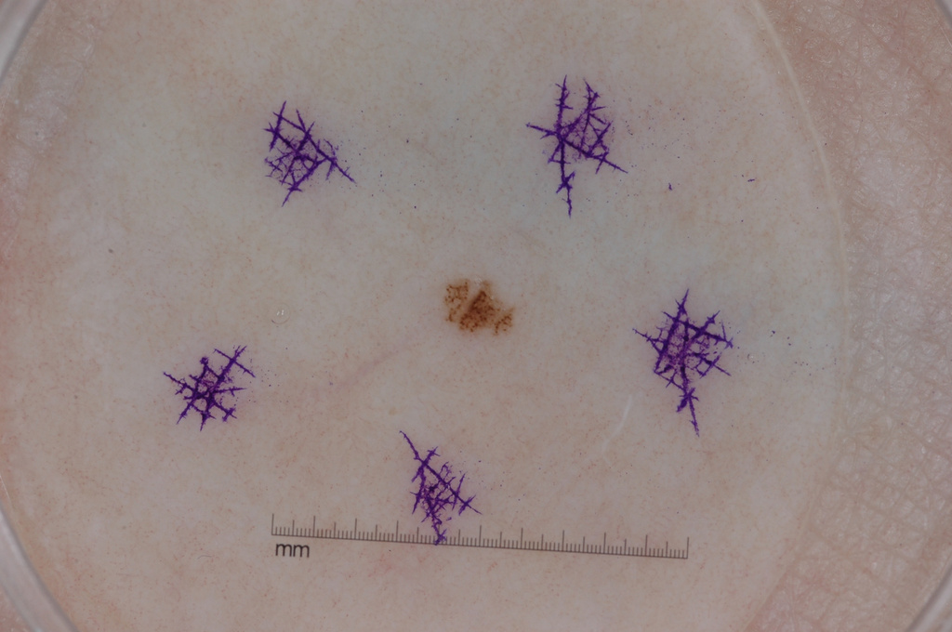
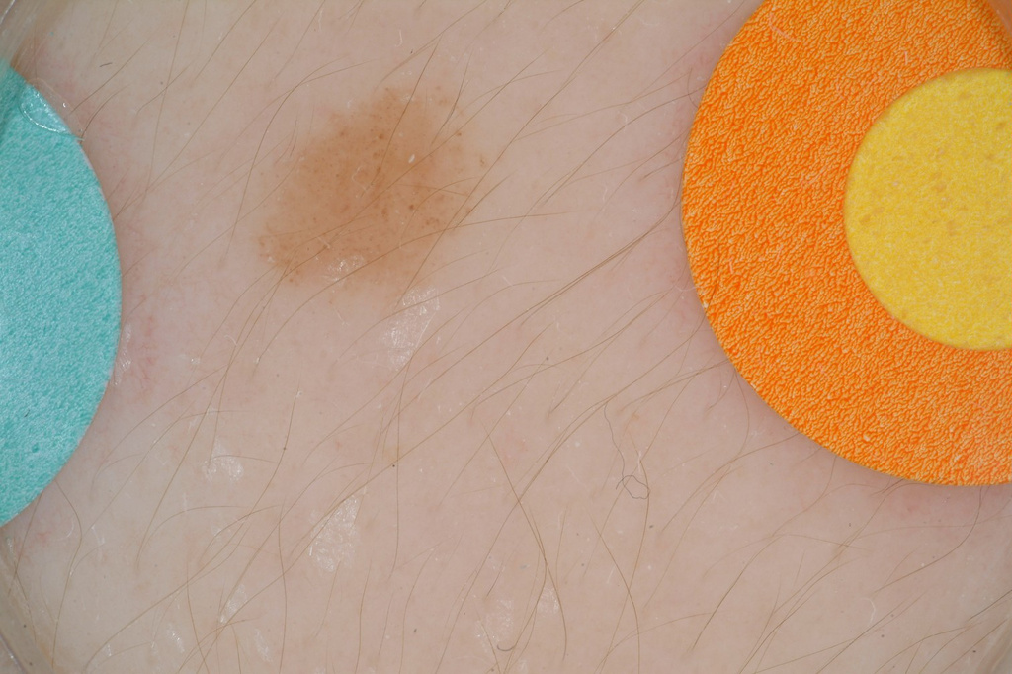
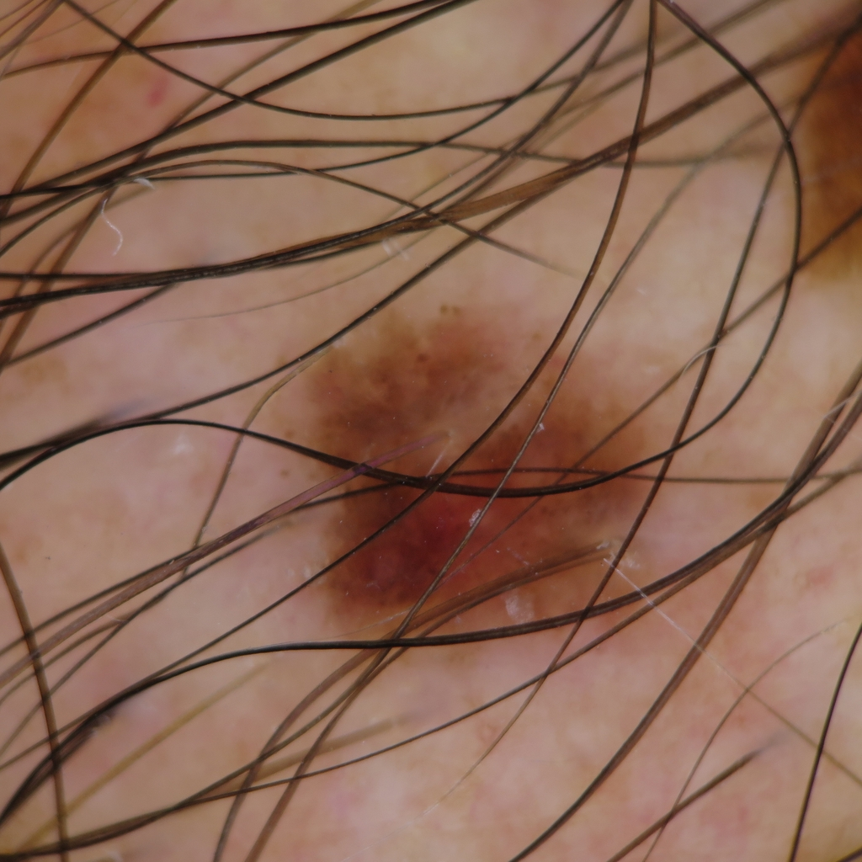
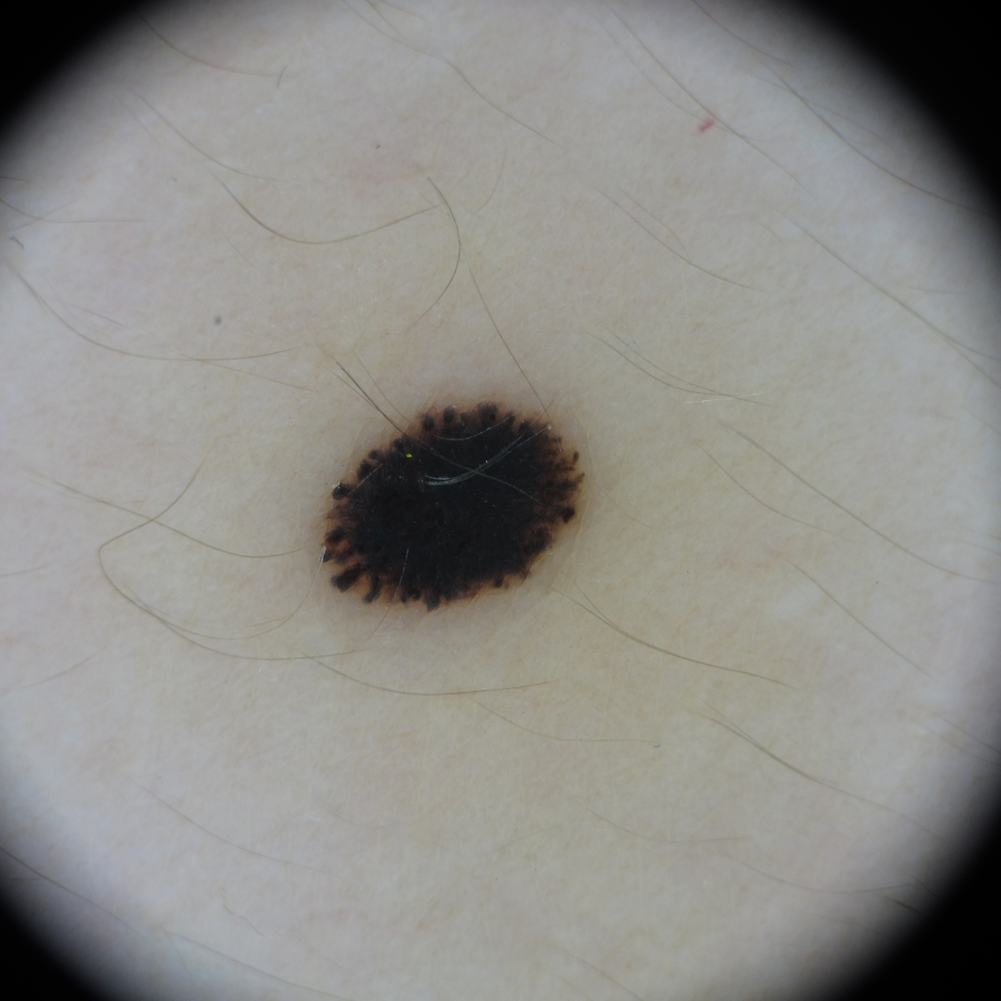
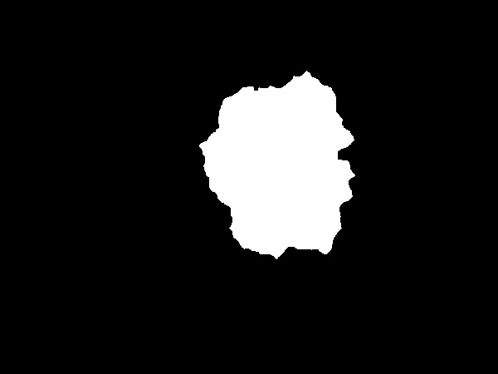
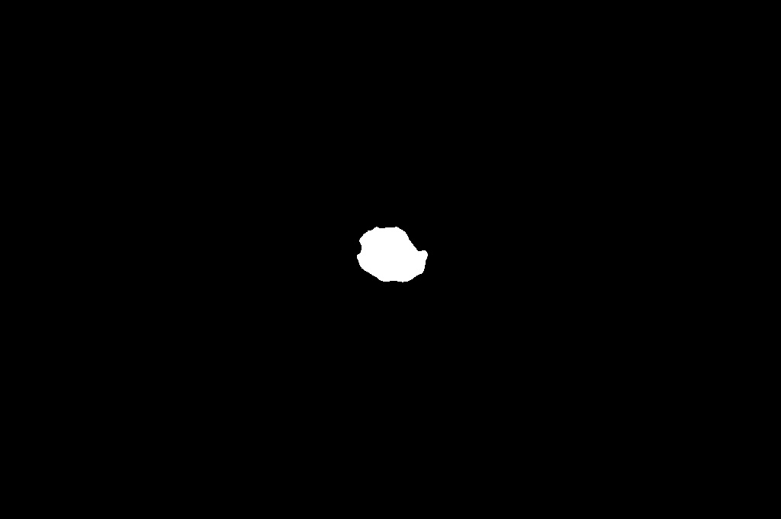
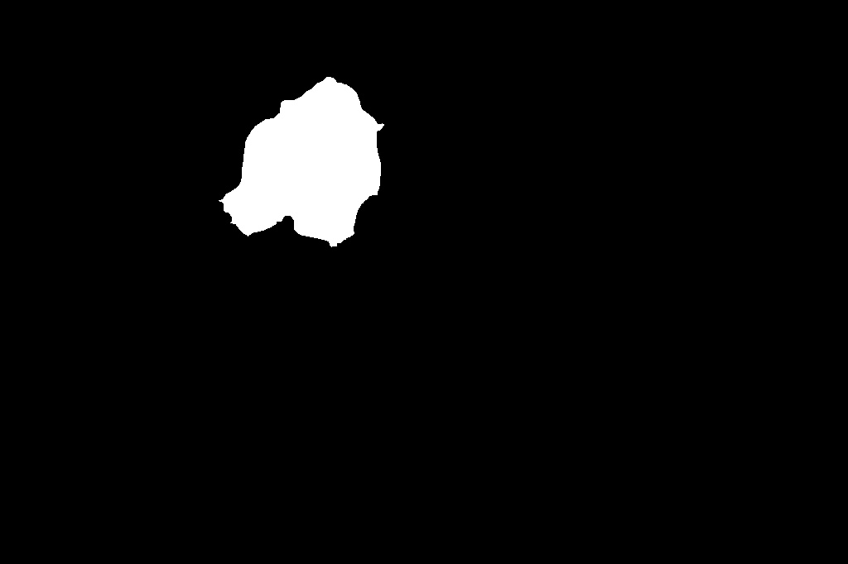

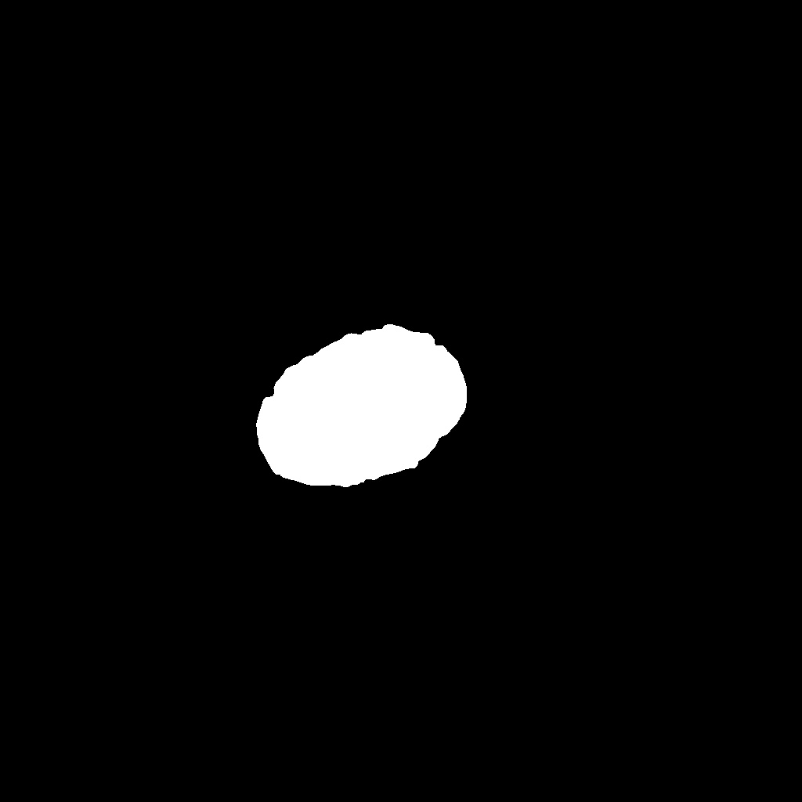
[2/7] Skin Lesion Segmentation _{(1/1)} ^{(*)}
Clear & simple to segment
Very small & similar objects surrounding
Multiple objects with lesion
A lot of hair on the lesion
Black corners surrounding
* Purely image processing! Detailed methodology can be found in the appendix slides, as this is an optional step in the project (yet improved the results).
Notes:
Skin lesion segmentation pipeline explanation is in the appendix. The segmentation approach was made using purely image processing and managed successfully to segment easy to difficult cases as demonstrated. The use of segmentation mask (as will be explained in the next slides) improved slightly the results.

Slide 7
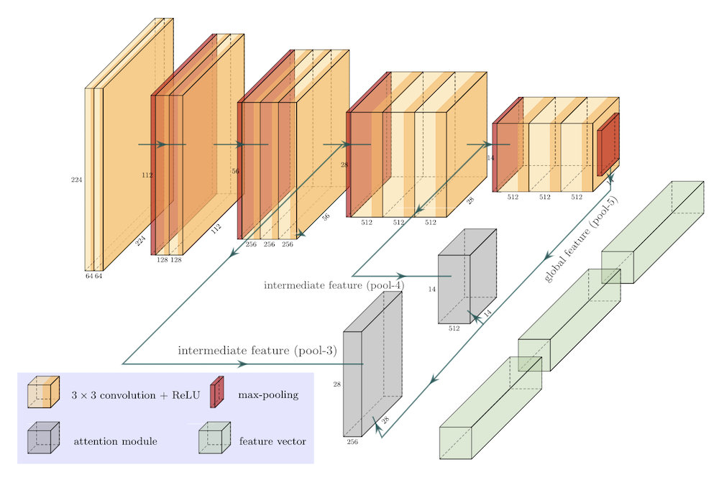
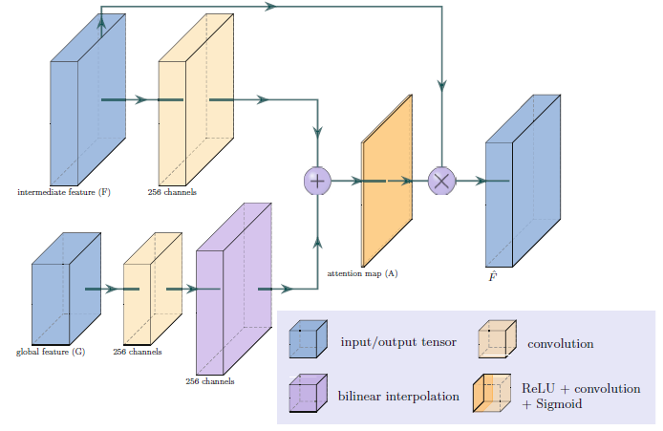
[3/7] Architectures (Base/Single Model) _{(1/2)}
Outputs: features (that we combine) + attention masks
(that we use with our segmentation in the loss term)
Uses visual attention blocks, concatenates its output features to base model feature vector, then into classifier layer.
Model is trained from scratch! Loaded pre-trained weights and initialized the classifier and both attention blocks using ‘kaiming normal’.
Same base architecture for binary and multi-class problem.
VGG16_BN Model
Attention Blocks X 2
The authors used a single model and claimed to be the state-of-the-art with a single model, reaching auc = 88% with masks. This model can work with/without masks. Can we do better?
Yan, Y., Kawahara, J., & Hamarneh, G. (2019). Melanoma recognition via visual attention. In Information Processing in Medical Imaging: 26th International Conference, IPMI 2019, Hong Kong, China, June 2–7, 2019, Proceedings 26 (pp. 793-804). Springer International Publishing.
Notes:
The initialization using “kaiming normal” is used to have a good starting points for the model parameters (weights & biases) to update the values from. The model is trained from scratch (takes longer time to train) and achieved good results.
The model can also use the segmentation masks during the training. It doesn’t take the masks as an input to the model, but as a mask to compare it using DICE with the attention mask to modify the training loss with a regularization factor.
How can we improve the results using this architecture? More details about the loss terms and different experiment configurations in the text slide.

Slide 8
[3/7] Architectures (Ensemble) _{(2/2)}
VGG16_BN_Attention
VGG16_BN Model
Attention Blocks
Let’s call the entire model as VGG16_BN_Attention.
Our approach is to combine both train and valid splits, the split into k-folds using StratifiedKFold; k=5.
Train k-Models, on every split. This is one way to handle imbalance of challenge 2! Combine using majority voting.
More robust results, as the valid split is always balanced, more data to train.
Can work with/without masks; will be discussed later in the configuration slides.
Data
Fold 1
VGG16_BN_Attention
k=1
Majority/Weighted Voting
Predictions
…
…
Fold 5
VGG16_BN_Attention
k=5
Notes:
We took the model a step further by building an ensemble of models (from the same base model) that were trained on different folds of the dataset (k = 5). As we have imbalance in challenge 2, we used StratifiedKFold that splits the data using stratified sampling with equal proportions to each class (after combining both train and validation splits). This is way better than random sampling that is made using normal Kfold CV. This is one way to train models with imbalanced dataset and achieved very high accuracy results.

Slide 9
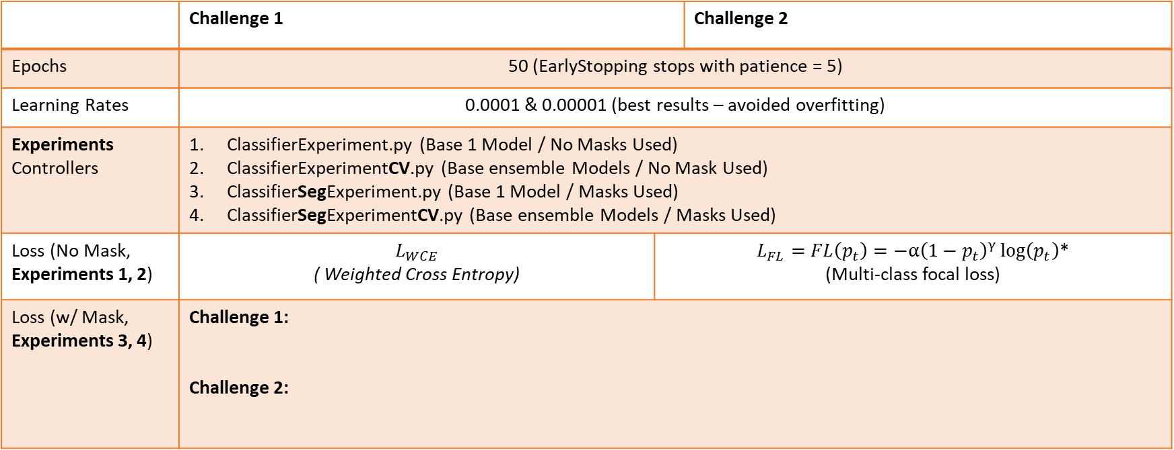
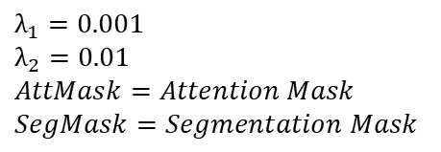
[4/7] Configurations
 | Challenge 1 |  | Challenge 2
Epochs | 50 (EarlyStopping stops with patience = 5)
Learning Rates | 0.0001 & 0.00001 (best results – avoided overfitting)
Experiments Controllers | ClassifierExperiment.py (Base 1 Model / No Masks Used) ClassifierExperimentCV.py (Base ensemble Models / No Mask Used) ClassifierSegExperiment.py (Base 1 Model / Masks Used) ClassifierSegExperimentCV.py (Base ensemble Models / Masks Used)
Loss (No Mask, Experiments 1, 2) | $$L_{WCE}$$ ( Weighted Cross Entropy) | $L_{FL}=FL\left(p_{t}\right)=−α{\left(1−p_{t}\right)}^{γ}\log\left(p_{t}\right)$* (Multi-class focal loss) | 1. Multi-class focal loss (No Masks, Experiments 1, 2) 2.
Loss (w/ Mask, Experiments 3, 4) | Challenge 1: Challenge 2:
$$λ_{1}=0.001$$
$$λ_{2}=0.01$$
$$AttMask=Attention Mask$$
$$SegMask=Segmentation Mask$$
$$L=L_{WCE}+ λ_{1}Dice(SegMask, AttMask1)+ λ_{2}Dice(SegMask, AttMask2)$$
$$L=L_{FL}+ λ_{1}Dice(SegMask, AttMask1)+ λ_{2}Dice(SegMask, AttMask2)$$
* Multi-class focal loss is initialized with weighted CE, making it handle class imbalance for challenge 2.
* The only difference between attention mask 1 and 2 are the sizes (different scale factor used).
Notes:
The attention blocks outputs features plus an attention mask. We compare it to the segmentation we made and produce a loss that is only used in the training loop to control the overall training loss based on the attention mask accuracy.
The use of the masks is not as an input to the model, but as an input to the dice loss in a way that we compare our segmentation masks to the attention masks generated from both of the attention blocks by the model to modify the training loss based on how the model see’s the data. Using the masks improved the results slightly compared to not using them. The regularization parameters values (lambda 1, 2) were the same values used in the official implementation made by the paper.

Slide 10
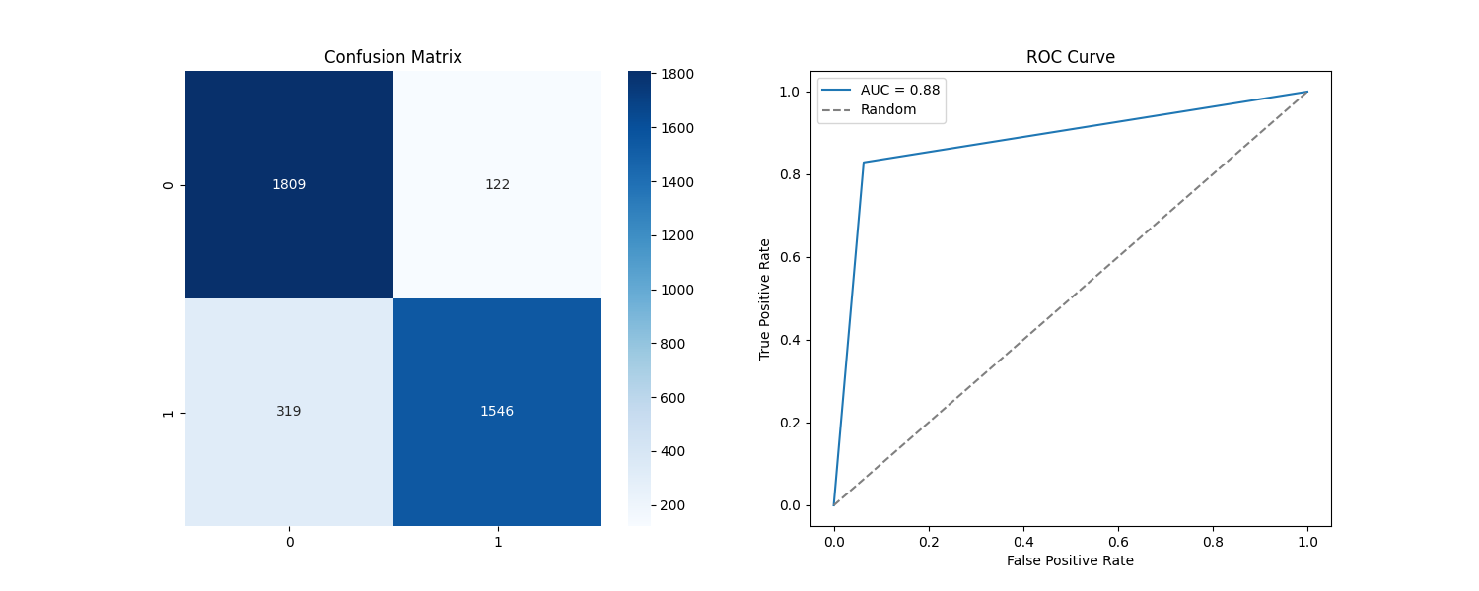
[5/7] Results and Discussion – Challenge 1 _{(1/4)}
Single (Base) model results, trained on training split only.
Config: Preprocessing + ( Hair + overall) Augmentation + Masks.
Accuracy: 88.3825
AUC: 88.2887
Kappa: 76.7159
Target 0: Sensitivity: 93.6820
Target 1: Sensitivity: 82.8954
Notes:
Those are the results obtained by using one model (base) same as the one made in the literature. The results are satisfactory and close to the results obtained by the author (auc), however, the kappa metric is still low, as well as target 1 sensitivity, which could be improved.

Slide 11
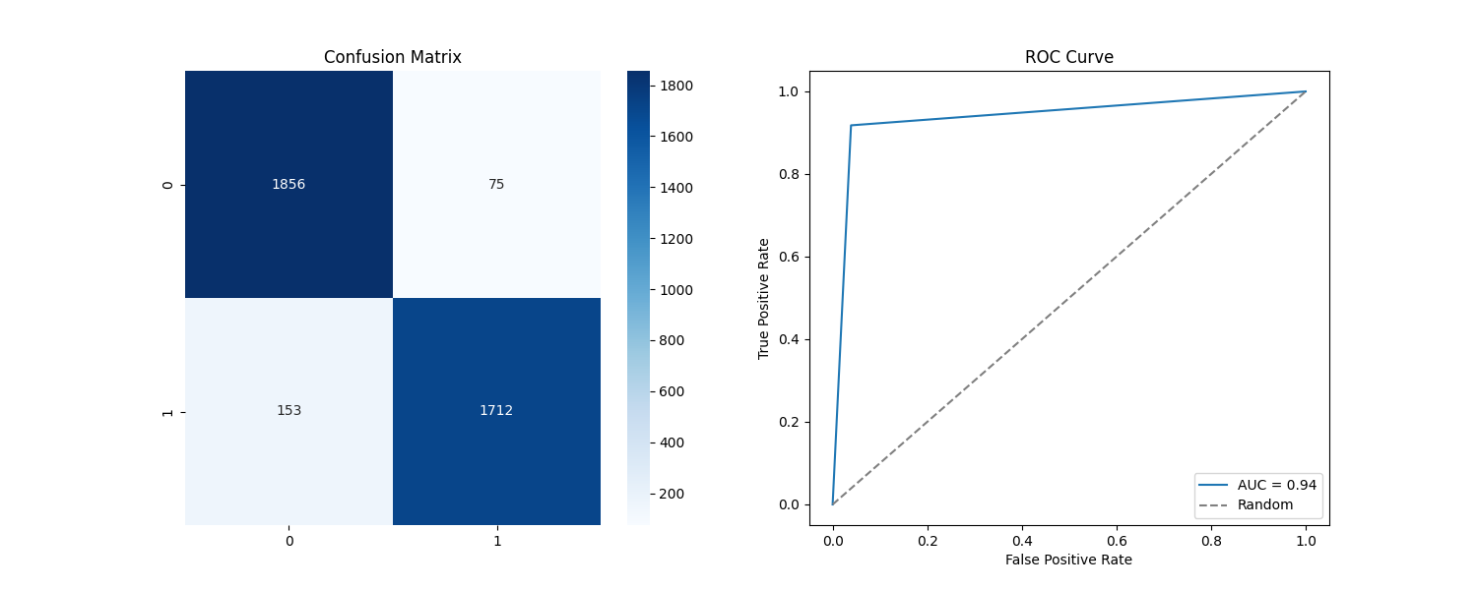
[5/7] Results and Discussion – Challenge 1 _{(2/4)}
Ensemble model results trained on k=5 splits. Results only using top 3 accuracy models (slight improvement than using all 5)*.
Config: Preprocessing + ( Hair + overall) Augmentation + Masks.
Accuracy: 93.9937
AUC: 93.9561
Kappa: 87.9751
Target 0: Sensitivity: 96.1160
Target 1: Sensitivity: 91.7962
Combination Strategy: Majority Voting
Training time: 5 days, 12 hours
+ 5.6112
+ 5.6674
+ 11.2492
+ 2.4340
+ 8.9008
improvement made by the ensemble. Used for test.
* Results obtained from all 5 models on the validation can be found in the appendix.
Notes:
We improved the results significantly with the ensemble. We trained an ensemble using 5-folds, and in the final evaluation and test submitted, we used only top 3 models that had the highest accuracies. The results of using only the top 3 were slightly better than using all 5 models. As we can see, the right color + value indicates the improvements made by the ensemble compared to the single model. Highlighting the significant improvement made by the ensemble for all the metrics compared to a single model.
The training time is very long for the following reasons:
The model is trained from scratch.
The preprocessing is integrated with the augmentation, taking long time to process.
Limited GPU power (6GB).
The combination strategy of Majority voting had better results than weighted voting.

Slide 12
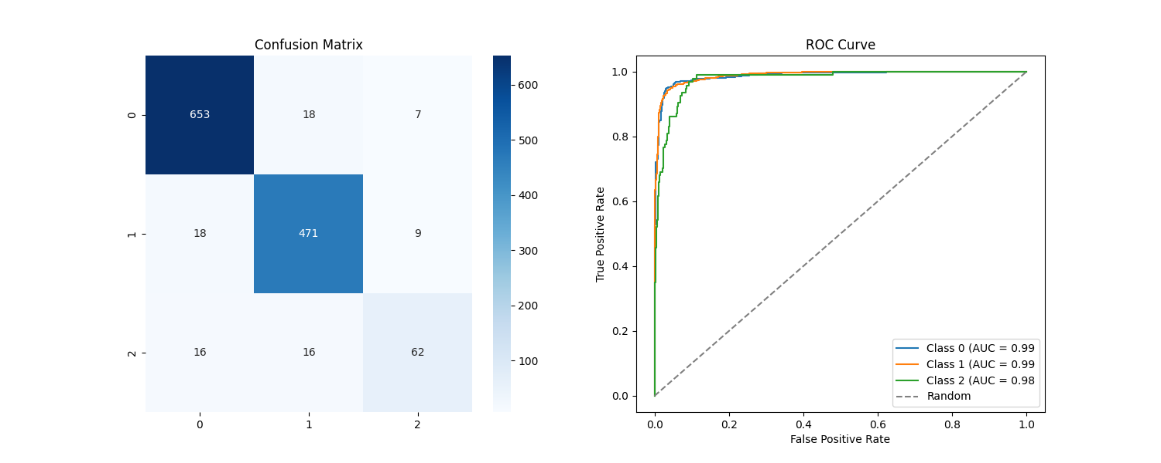
[5/7] Results and Discussion – Challenge 2 _{(3/4)}
Single (Base) model results, trained on training split only.
Config: Preprocessing + ( Hair + overall) Augmentation + Masks.
Accuracy: 93.3858
AUC: 98.4695
Kappa: 87.9904
Target 0: Sensitivity: 96.3127
Target 1: Sensitivity: 94.5783
Target 2: Sensitivity: 65.9574
Notes:
Same for multi-class. The results were very high (probably outperformed the implementation of the author, not sure); Target 2 sensitivity was very low for a single model.

Slide 13
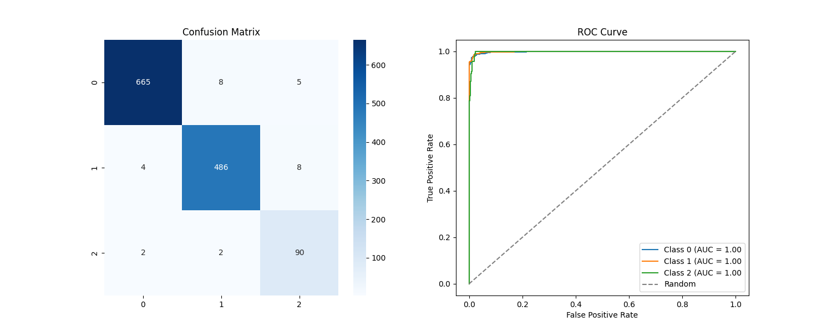
[5/7] Results and Discussion – Challenge 2 _{(4/4)}
Ensemble model results trained on k=5 splits. Results only using top 3 accuracy models (slight improvement than using all 5)*.
Config: Preprocessing + ( Hair + overall) Augmentation + Masks.
Accuracy: 97.7165
AUC: 99.8283
Kappa: 95.9136
Target 0: Sensitivity: 98.0826
Target 1: Sensitivity: 97.5904
Target 2: Sensitivity: 95.7447
Combination Strategy: Majority Voting
Training time: 3 days, 9 hours
+ 4.3307
+ 1.3588
+ 7.9232
+ 1.7699
+ 3.0121
+ 29.7873
improvement made by the ensemble. Used for test.
* Results obtained from all 5 models on the validation can be found in the appendix.
Notes:
Like the binary problem, we used top 3 accuracy models as they had slight improvement to using all 5-fold models. The results improved a lot for the sensitivity for target 2, making all sensitivity for all classes > 95%. The kappa value also was very high almost 96%. Combination strategy that performed better was majority voting.

Slide 14
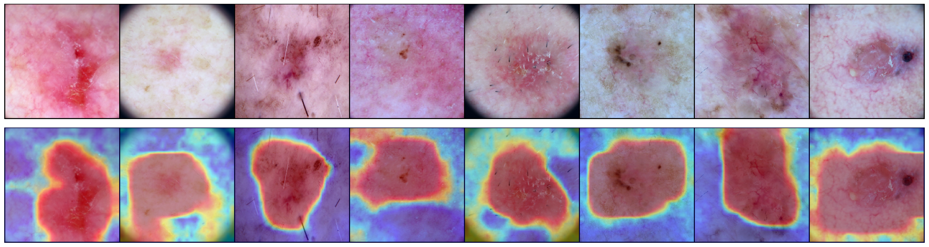
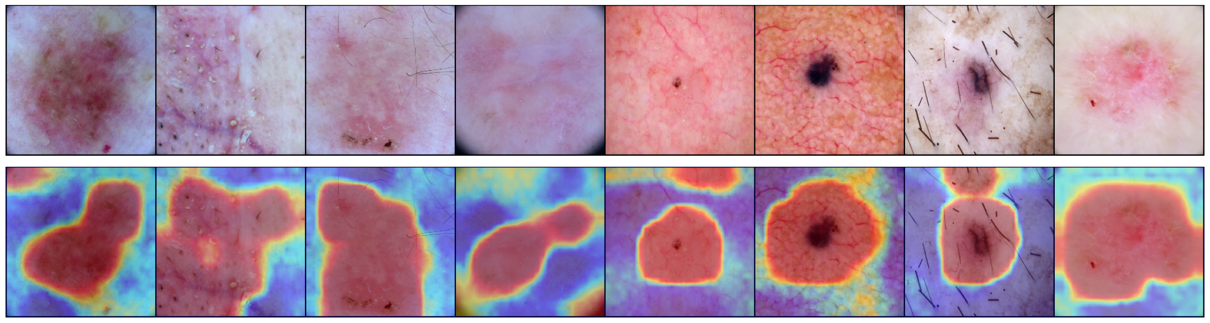
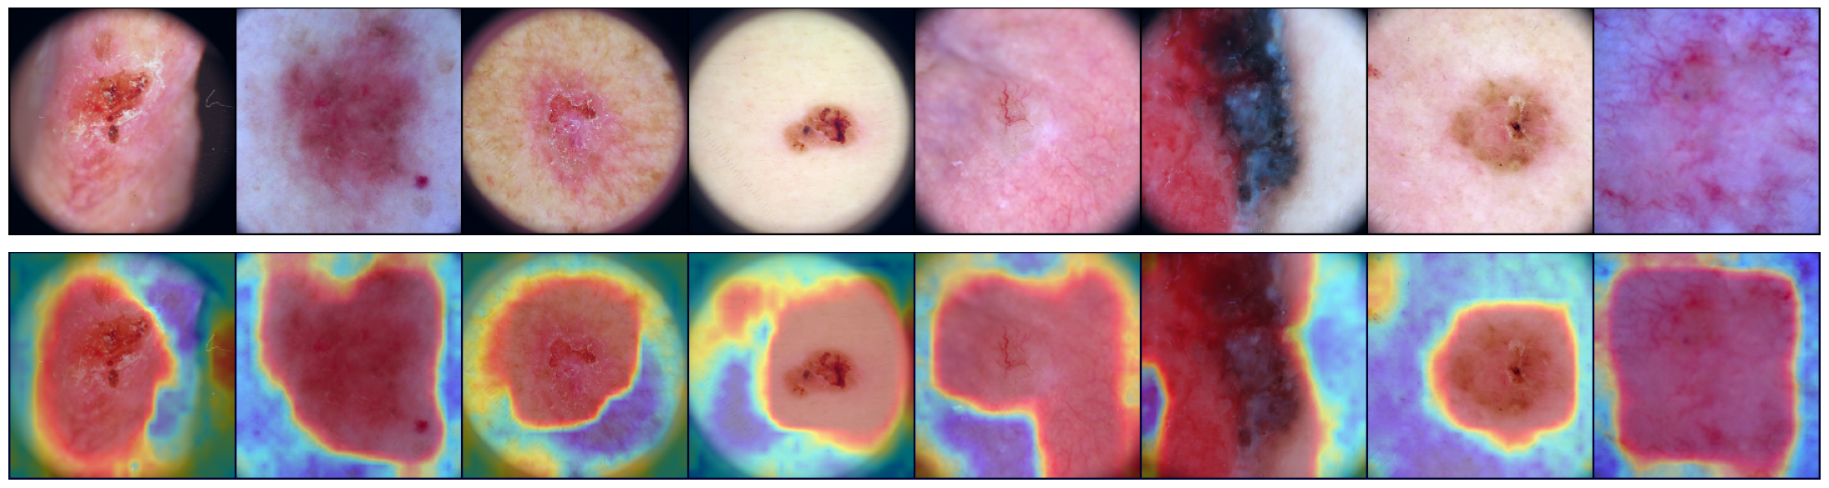
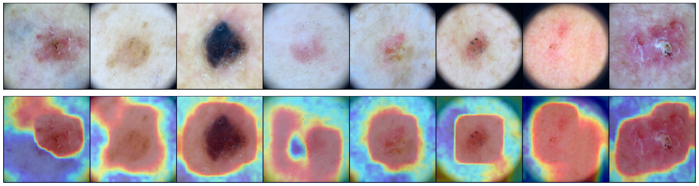
[6/7] Grad-CAM Visualization
Model Fold = 3, Challenge = 2, Split = Validation, Attention Map = 1 (pooling layer 3)
Notes:
Grad CAM visualization of the attention maps generated from pooling layer 3 (first attention map/block) on challenge 2 validation split.

Slide 15
[7/7] Conclusion
Ensemble approach improves the results significantly, given the same (best) model is trained on different splits of the dataset.
Useful approaches to handle class imbalance:
StratifiedKFold (with ensemble).
Multi-class focal loss.
Augmentation.
Visual attention blocks + segmentation masks improved slightly the results, by contributing to the training loss.
Augmenting the hair slightly increased the results, making the hair challenge not focused on a specific group of images, and avoiding inpainting all the dataset.
Skin Hair Dataset (Drive Download): https://drive.google.com/drive/u/1/folders/1eNltv3y3yea7wx6mPUag8VvydgJss_mb
Code (GitHub Repository): https://github.com/abdel-habib/ISIC2019-skin-lesion-classification-segmentation

Slide 16
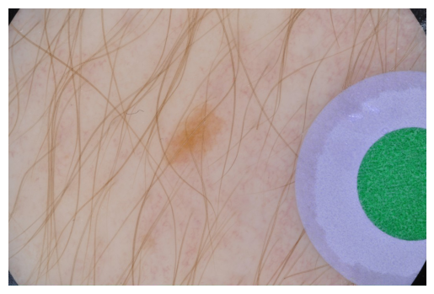
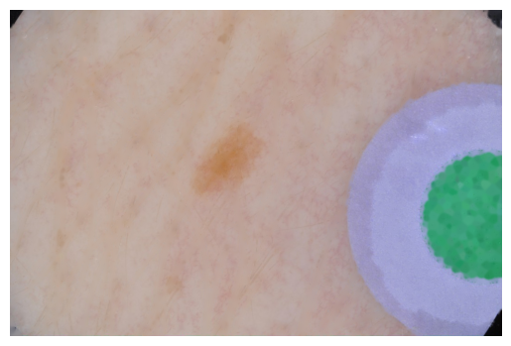
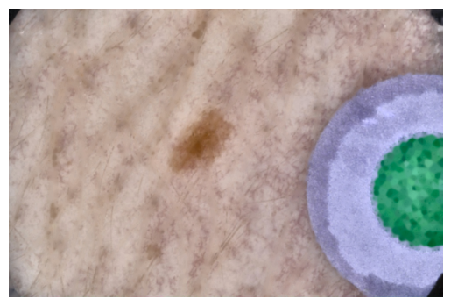
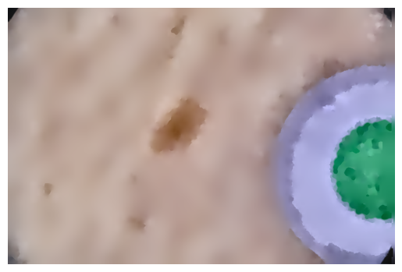
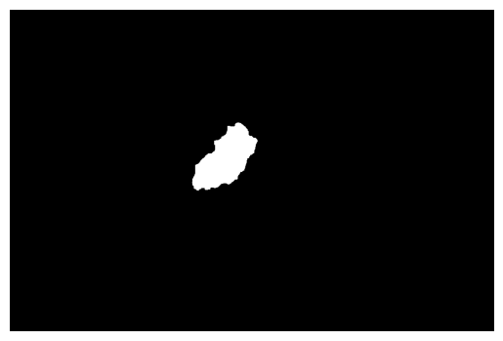


[Appendix] Skin Lesion Segmentation
Raw
Crop Frame, Extract Hair
Gaussian Filter, CLAHE
Mean Shift Filter (Pyramid = 4)
Keep Largest Center Region
Erode – Remove Lines
Remove Circular Borders
KMeans (K=2)
Most of the lesions are in the center of the frame.
Helps removing remaining hair
Removes microscopic corners (if not cropped)

Slide 17
[Appendix] Architectures (Base)
Outputs: features (that we combine) + attention masks
(that we use with our segmentation in the loss term)
VGG16_BN Model
Attention Blocks
X 2
Yan, Y., Kawahara, J., & Hamarneh, G. (2019). Melanoma recognition via visual attention. In Information Processing in Medical Imaging: 26th International Conference, IPMI 2019, Hong Kong, China, June 2–7, 2019, Proceedings 26 (pp. 793-804). Springer International Publishing.
Notes:
The final architecture followed is using VGG16_BN and two attention blocks, that was implemented for melanoma recognition. We didn’t use the same exact code but wrote it from scratch and compared the implementation and result to the author results, with also using the official implementation as guidance, and specific numbers for the architecture to be the same. Each of the attention blocks outputs both the features (that are combined with the model features before entering into the classifier layer), and an attention map (that we can use as a mask to compare it with our segmentation mask).

Slide 18

[Appendix] Results and Discussion – Challenge 1
Ensemble model results, trained using k=5 folds (using all 5 models).
Config: Preprocessing + ( Hair + overall) Augmentation + Masks.
Accuracy: 93.5194
AUC: 93.481
Kappa: 87.0255
Target 0: Sensitivity: 95.7017
Target 1: Sensitivity: 91.2600
Combination Strategy: Majority Voting
Training time: 5 days, 12 hours
+ 5.1369
+ 5.1923
+ 10.3096
+ 2.0197
+ 8.3646
+ number – improvement made by the ensemble.
Notes:
Ensemble results obtained using all 5 models.

Slide 19

[Appendix] Results and Discussion – Challenge 2
Ensemble model results, trained using k=5 folds (using all 5 models).
Config: Preprocessing + ( Hair + overall) Augmentation + Masks.
Accuracy: 97.5591
AUC: 99.8111
Kappa: 95.6179
Target 0: Sensitivity: 97.7876
Target 1: Sensitivity: 97.9919
Target 2: Sensitivity: 93.6170
Combination Strategy: Majority Voting
Training time: 3 days, 9 hours
+ 4.1733
+ 1.3416
+ 7.6275
+ 1.4749
+ 3.4136
+ 27.6596
+ number – improvement made by the ensemble.
Notes:
Ensemble results obtained using all 5 models.

